Slide 1

Kotlin

Slide 2

Kotlin
I am 100% JVM compatible
Statically typed programming language
Blend of the best features in all languages
- Am I just another one ?

Slide 3






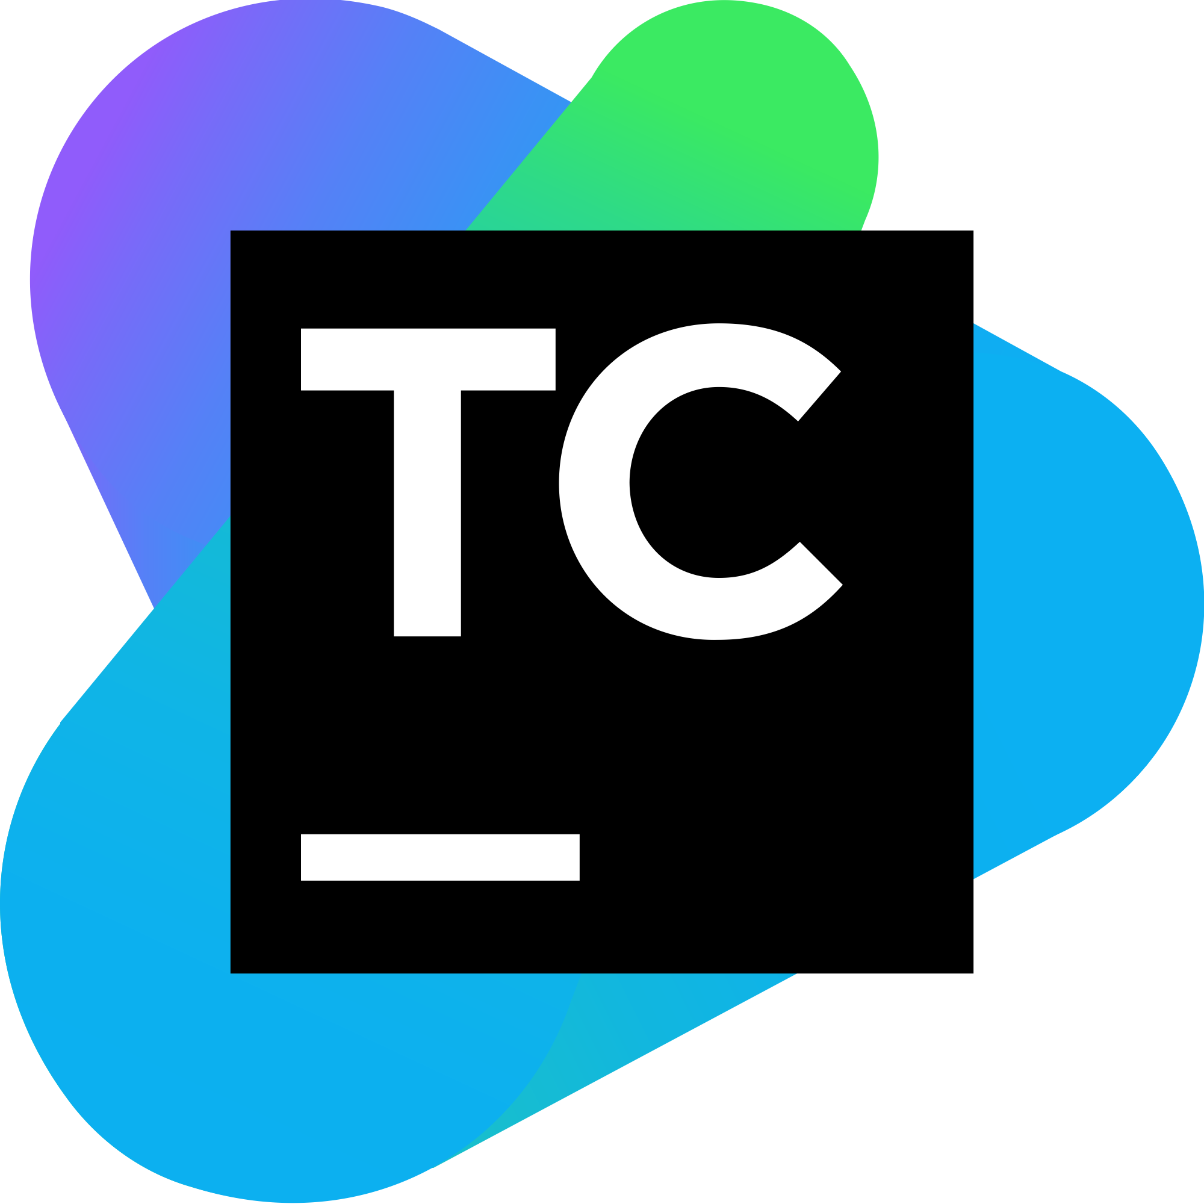


Slide 4
Why Kotlin now ?
JetBrains has there own needs and now we have our own

Slide 5
Productivity
IDE Sales
Reputation
Total success!
That’s a lot of money
And a lot of users

Slide 6

Google makes Kotlin a first-class language

Slide 7


Slide 8
2.1 M
Lines of Code in 2016
Lines of Code in 2017
10 M

Slide 9
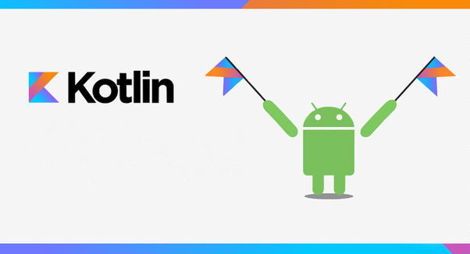
What's so exciting about Kotlin for Android and Enterprise developers?

Slide 10
Kotlin is 100% interoperable with Java
Kotlin compiles to .class

Slide 11
Java is old on Android. Kotlin, It's unashamed

Slide 12
Kotlin is multi-platform & supports Scripting

Slide 13
The Kotlin is easy to learn, especially for Java developer

Slide 14

Tools & Support
It’s really important and worlds best IDE Company is backing us.

Slide 15
Kotlin Sits on the Shoulders of Giants

Slide 16
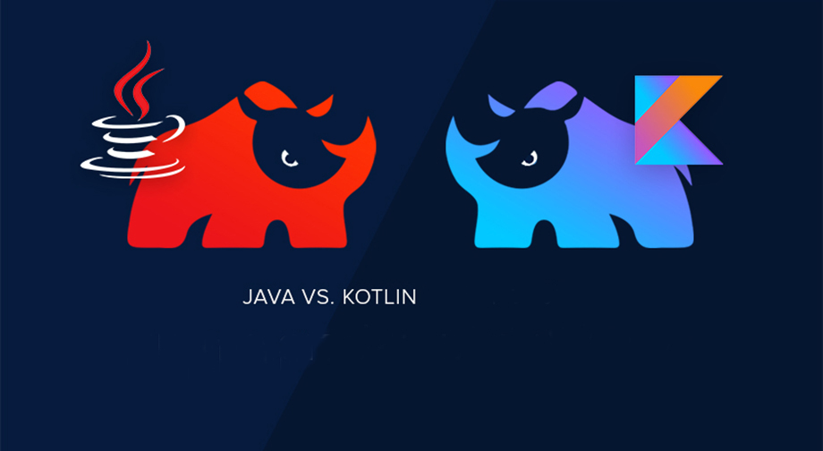
Key difference
With Kotlin write less code, be happy

Slide 17
No Static and Primitive Types
; is optional

Slide 18
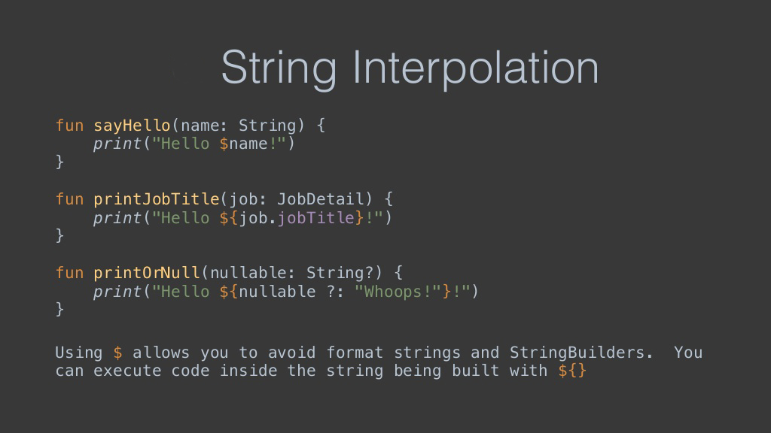

Slide 19
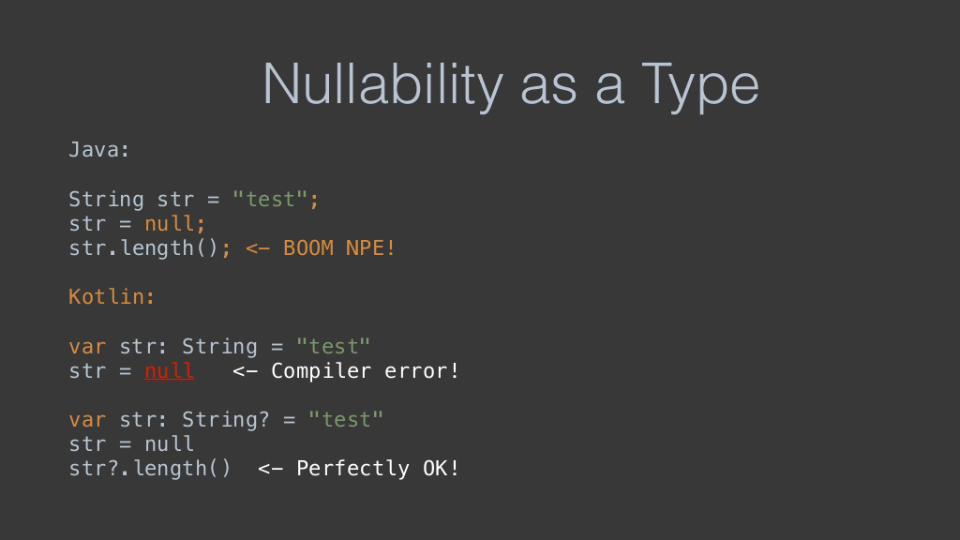

Slide 20
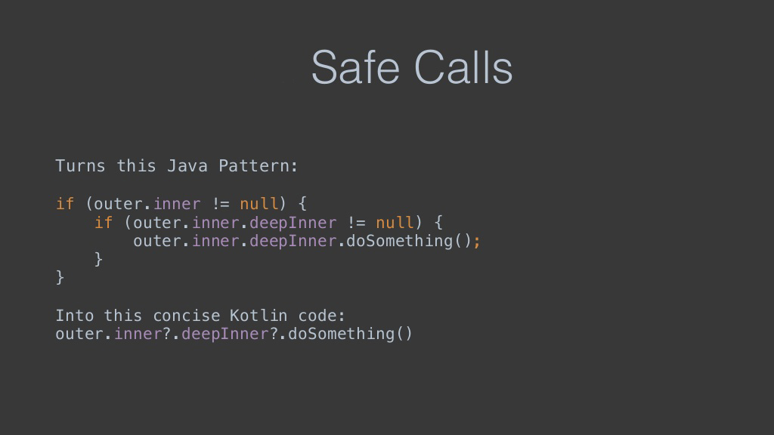

Slide 21
Data Class are Java Pojo & Deep cloning is free

Slide 22
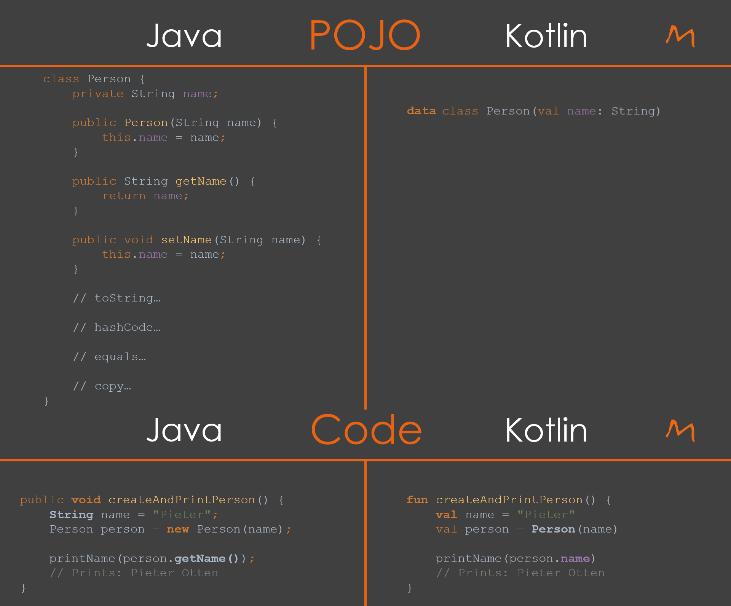

Slide 23
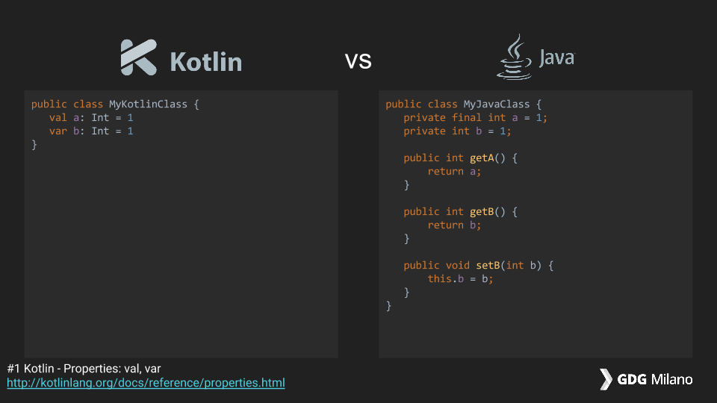

Slide 24
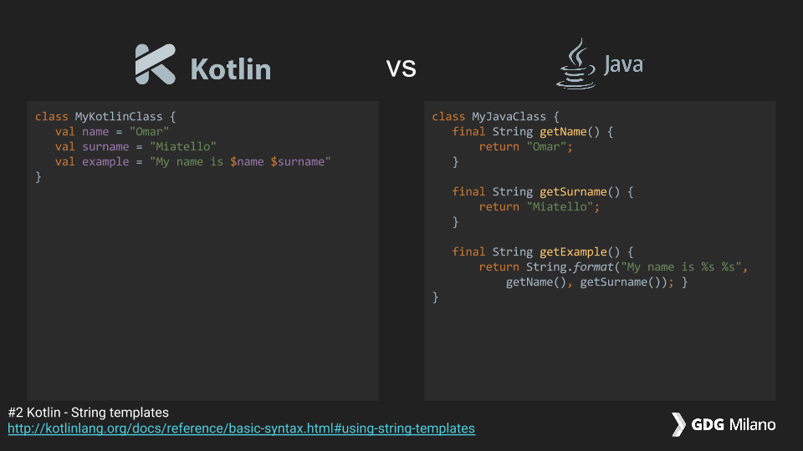

Slide 25
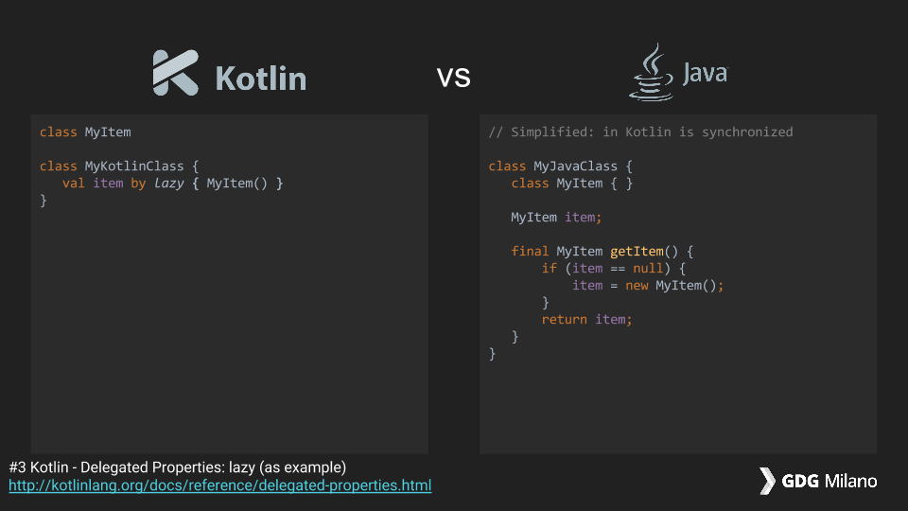

Slide 26
Named and Default Params
fun named(message:String = "Success", statusCode:Int= 200)
= println("message $message, statusCode $statusCode")
named();
named("Failed");
named(statusCode = 500)
message Success, statusCode 200
message Failed, statusCode 200
message Success, statusCode 500

Slide 27
Extention Functions

Slide 28
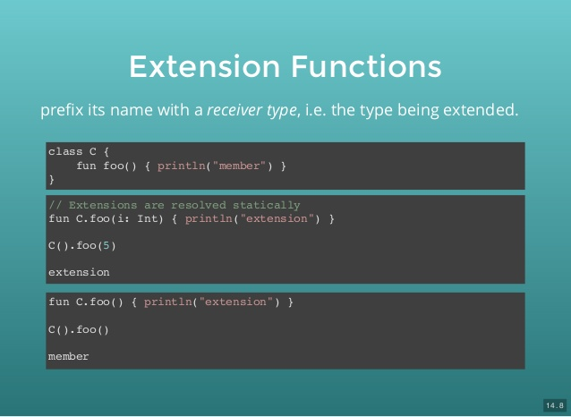

Slide 29
Lamda & Streams & Others

Slide 30
It makes Android development much easier with simplified API

Slide 31


Slide 32

It makes Android development much easier

Slide 33
THANKS!
Any questions?
You can find me at:
srikrishna.s@sella.it

